Slide 1
SOFTWARE PROJECT MANAGEMENT (SPM)
MASTER OF COMPUTER APPLICATION
BY NARENDER KESWANI [DIVISION: B] [ROLL NO: 24]
Guide/Mentor: Mrs. Mona Deshmukh

Slide 2
PROBLEM STATEMENT:
IDENTIFY A BILL/LAW WHICH WAS PREPARED AFTER TAKING SUGGESTIONS FROM THE CITIZENS
CREATED BY : NARENDER KESWANI

Slide 3
BILL/LAW:
The Shakti Criminal Laws (Maharashtra Amendment) Bill, 2020
CREATED BY : NARENDER KESWANI

Slide 4
KEY FEATURES:
The Bill introduces death penalty for certain offences against women and children such as rape.
Punishment for certain offences such as providing false information and throwing acid has been enhanced.
The Bill proposes a shorter timeline for the investigation, trial, and disposal of appeal of certain offences.
LAW/BILL PASSED ON : 23/12/2021 BY MAHARASHTRA GOVERNMENT
CREATED BY : NARENDER KESWANI

Slide 5
Offences | Act (min-max) | 2020 Bill (min-max)
POCSO Act, 2012
Sexual assault | 3 - 5 years | 5 - 7 years
Aggravated sexual assault | 5 - 7 years | 7 - 10 years
Penetrative sexual assault of a child below 16 years of age | 20 years – life imprisonment; and a fine | 20 years - death; and a fine of at least five lakh rupees
IPC, 1860
Voluntarily throwing or attempting to throw acid | 5 - 7 years | 7 - 10 years
Intentionally providing false information to a public servant | Six months (maximum) | 1 year (maximum)
Reference : https://prsindia.org/bills/states/the-shakti-criminal-laws-maharashtra-amendment-bill-2020
CREATED BY : NARENDER KESWANI

Slide 6
INFORMATION GATHERING TECHNIQUES:
Last Date to apply was: 15 January 2021 till 5:00 pm
POST
Rajendra Bhagwat, secretary, Maharashtra legislature, secretariat, Vidhan Bhavan, Backbay, Reclamation, Mumbai - 400032
EMAIL
a1.assem-bly.mls@gmail.com
CREATED BY : NARENDER KESWANI

Slide 7
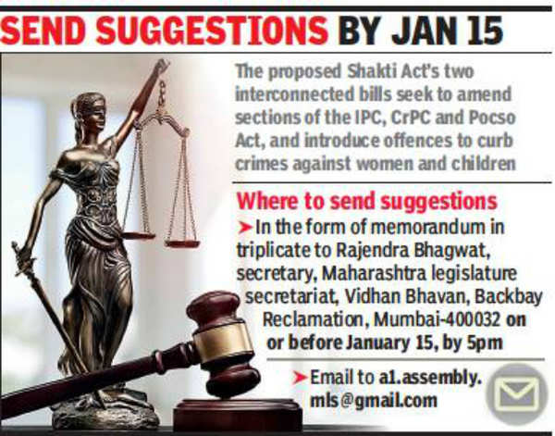
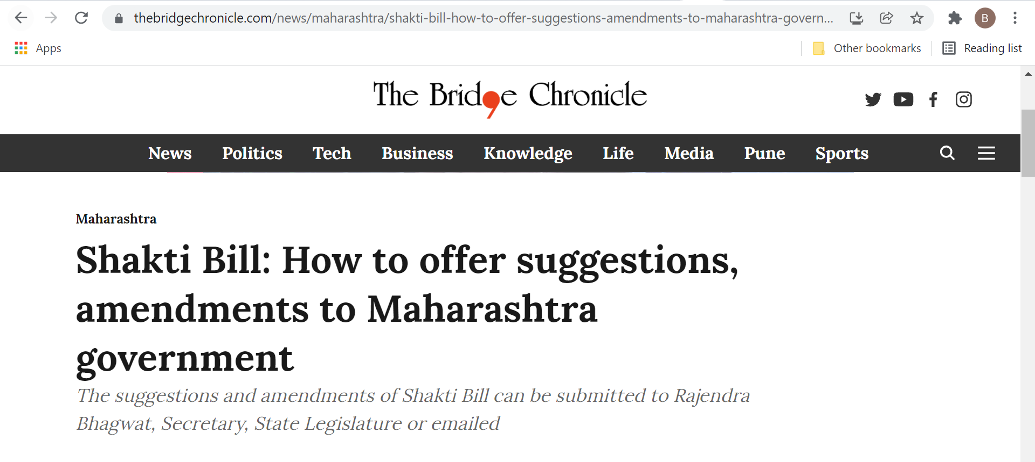
ADVERTISEMENT:
TIMES OF INDIA
https://timesofindia.indiatimes.com/city/mumbai/citizen-feedback-sought-on-draft-maharashtra-shakti-bill/articleshow/80089498.cms
THE BRIDGE CHRONICLE
https://www.thebridgechronicle.com/news/maharashtra/shakti-bill-how-to-offer-suggestions-amendments-to-maharashtra-government
CREATED BY : NARENDER KESWANI

Slide 8
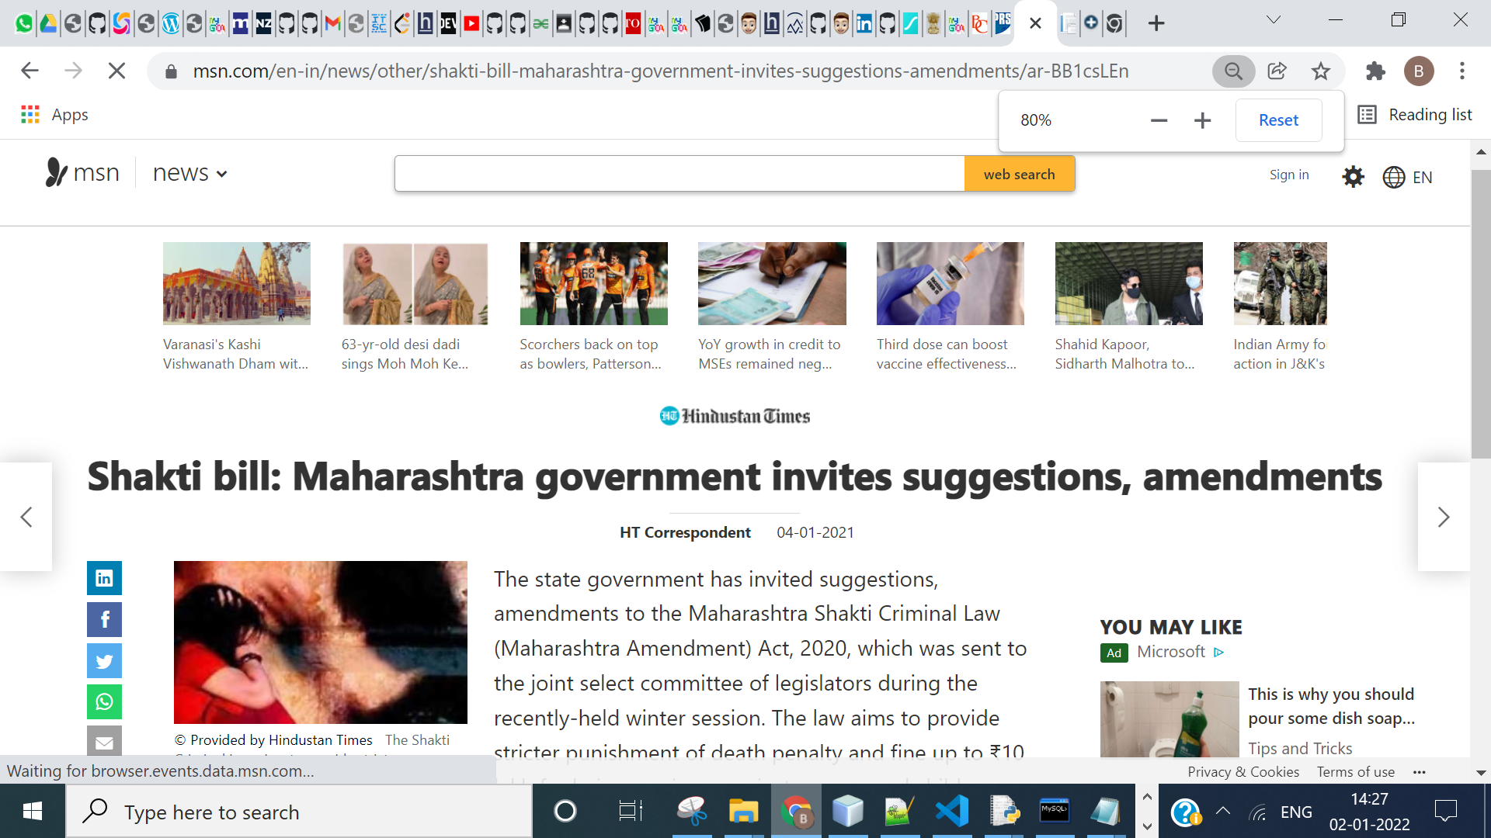
ADVERTISEMENT:
MSN (Hindustain Times)
https://www.msn.com/en-in/news/other/shakti-bill-maharashtra-government-invites-suggestions-amendments/ar-BB1csLEn
CREATED BY : NARENDER KESWANI

Slide 9
THANKYOU
CREATED BY : NARENDER KESWANI

